Slide 1

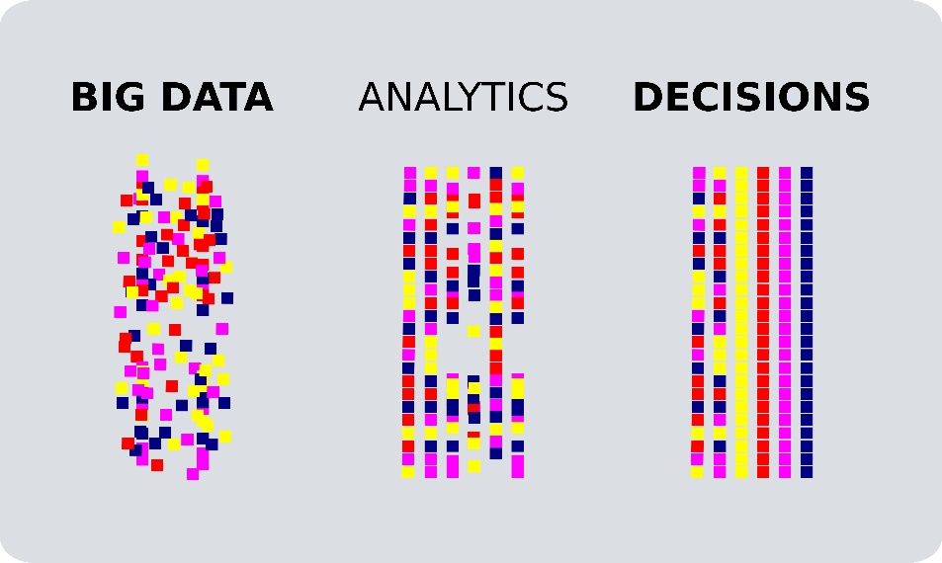

Big Data on Campus Leveraging OUHSC Bioinformatics to Inform Research & Practice
David Bard, PhD
William Beasley, phd
Thomas Wilson, MPH
University of Oklahoma HSC
Biomedical & Behavioral Methodology Core
Zsolt Nagykaldi, PHD
Department of family medicine
April 23, 2019

Slide 2
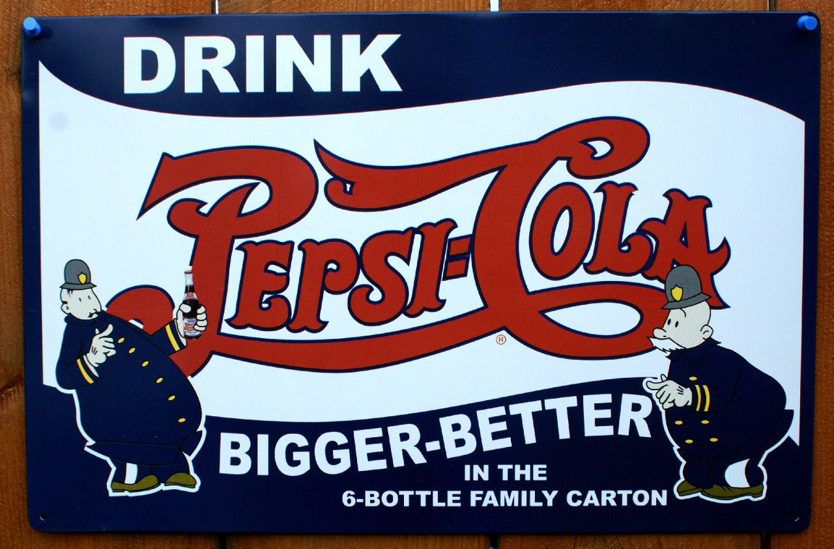
Notes:
It’s an old concept

Slide 3

Notes:
It’s a new concept

Slide 4
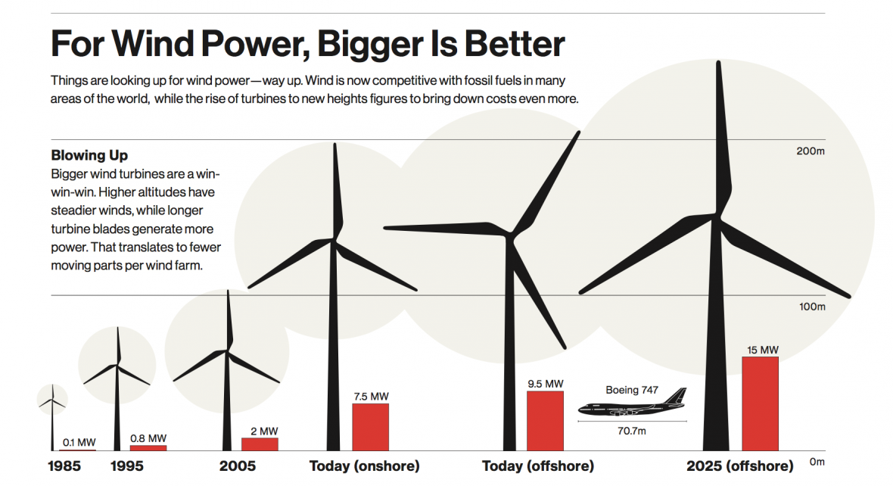
Notes:
It’s a futuristic concept

Slide 5

Notes:
In some sense…

Slide 6

Notes:
It’s a law of nature

Slide 7

“The bigger the better; in everything”
Freddie Mercury

Slide 8
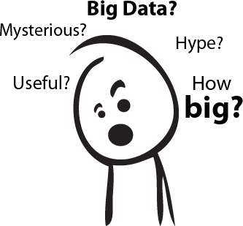
Notes:
What is Big Data?
Extremely large data sets (usually containing raw data) that may be analyzed computationally to reveal patterns, trends, and associations, especially relating to human behavior and interactions.
Why is it important?
Improve care, save lives, and lower costs (some estimates reach $300 Billion/year in U.S.)
The promise of predictive analytics
Predict cost-effective best practices, disease surveillance, etc.
The promise of prescriptive analytics
Adaptive interventions that redirect patient health trajectories that drift off-course
Enables personalized medicine via advanced clinical decision support
What is the future of Big Data?
As data capture technologies (e.g,. fitness monitoring devices, the eventual Internet of Things) continue to evolve, we be accumulating more and more Big Data
Big data is said to be the future of healthcare. As health record digitization increases, new opportunities arise to make clinically important decisions and answer questions previously intractable.

Slide 9
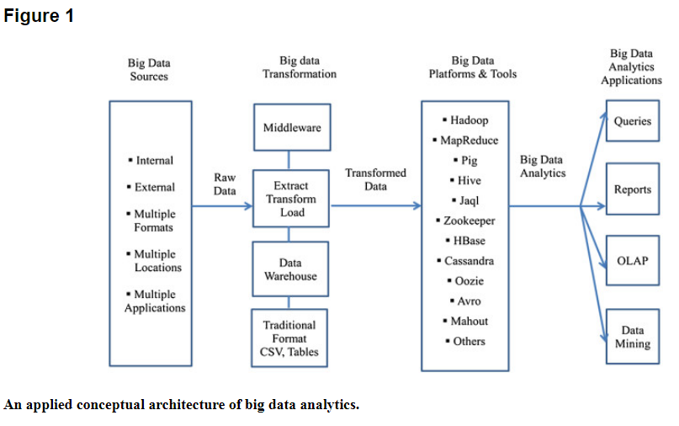
Health Inf Sci Syst. 2014; 2: 3. doi: 10.1186/2047-2501-2-3

Slide 10

Notes:
Population health control/surveillance – identify disease susceptibility and optimize resource allocation.
We use data to know where the health burdens are, to signal anomalies and health risks, and to inform actions and interventions that can keep people safer and healthier. Our understanding of the public’s health is only as good as the data we have, and CDC works around the clock to get the right information into the right hands at the right time.
Opioid surveillance example:
With the rapidly evolving opioid overdose epidemic, ED data can serve as an early warning system, alerting communities to changes in prevalence of overdoses and permitting a timely, informed, and localized response that could facilitate a more rapid and coordinated response including targeting of resources (e.g., increase naloxone supply to affected areas), and issuance of emergency health alerts or advisories. EDs also can serve as a point of intervention for persons who experience an overdose and are at higher risk for a subsequent overdose. Educating ED physicians and staff members about appropriate services for immediate care and treatment and post-overdose protocols are important to preventing future overdoses among their patients. ED physicians could assess history of prescription drug use during care by accessing data from prescription drug monitoring programs and provide education to patients. Post-overdose protocols can help prevent subsequent overdose by providing naloxone and connecting patients with case management services or peer navigators to help link them into treatment and harm reduction services, including syringe services programs (12). Opioid overdoses continue to increase in most jurisdictions, and rapid response efforts and a multisectoral approach are needed to reduce and prevent overdoses and their associated morbidity and mortality.

Slide 11

Notes:
California-based Kaiser Permanente discovery of adverse drug effects and subsequent withdrawal of Vioxx
Kaiser Permanente connected clinical and cost data to provide crucial data set that led to the discovery of adverse drug effects and subsequent withdrawal of the drug Vioxx from the market.

Slide 12
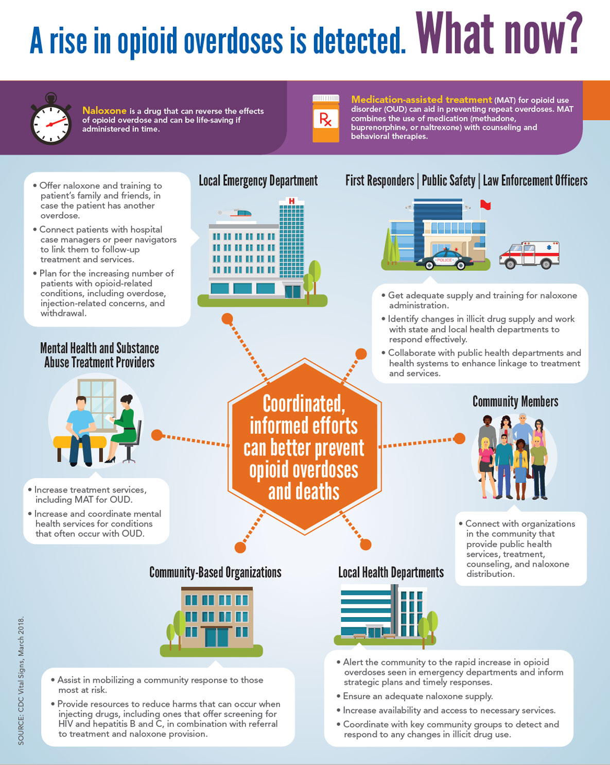

Slide 13
Clinical Decision Support

Slide 14
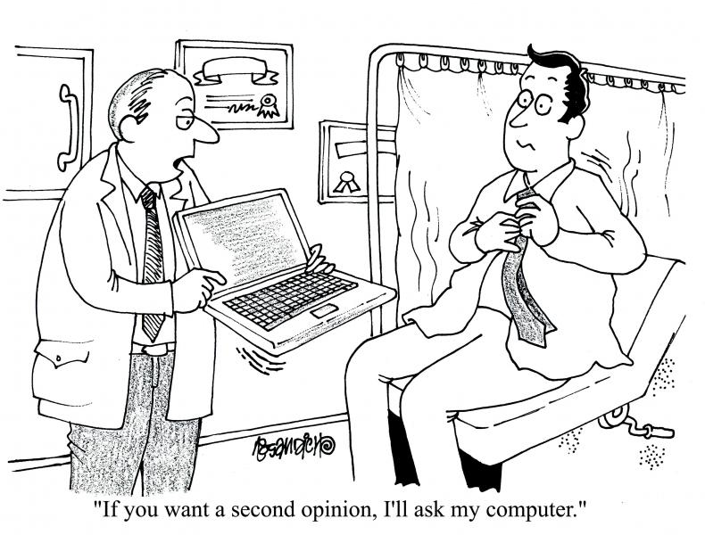
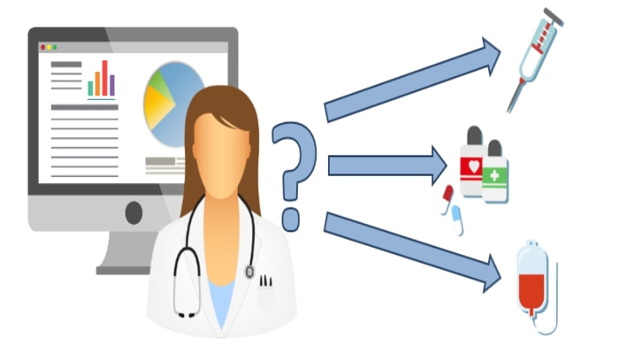
Notes:
Clinical Decision Support- better treatment recommendations, diagnostics, & decisions

Slide 15
Personalized/Precision Medicine

Slide 16
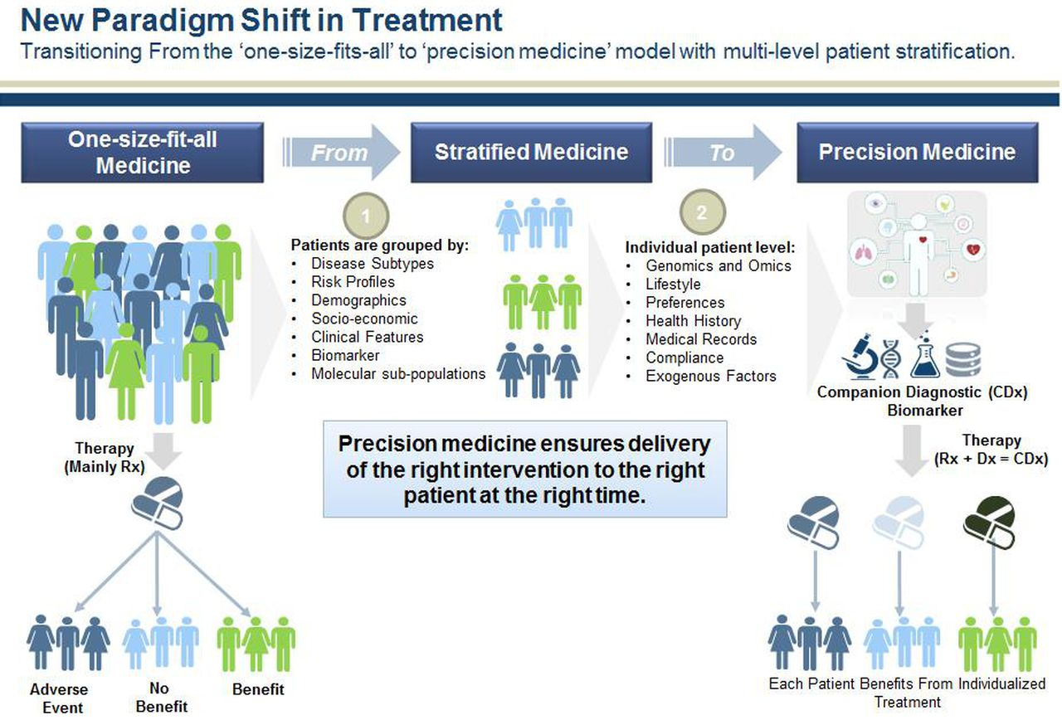
Notes:
Personalized Care, precision medicine- identify which treatments work for whom
Even more importantly is how these technologies are helping to create a new scientific revolution in which platforms like The Cancer Genome Atlas and the Materials Genome Initiative comb through far more data than a person ever could, detect patterns and open up new possibilities.
Yet what's truly amazing is that very little of this was viable even a decade ago and we've done little more than scratch the surface up till this point. In the future, it seems clear that our technology will advance to where even the highly unlikely becomes a sure bet.

Slide 17

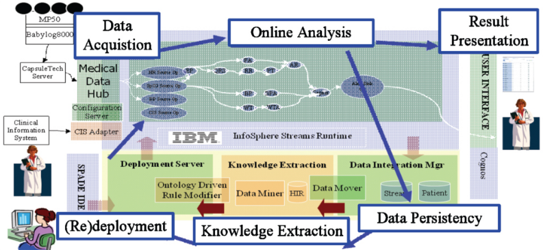


Notes:
Toronto’s Hospital for Sick Children, the University of Ontario Institute of Technology (UOIT) in Oshawa, Ont., and IBM Canada. To detect life-threatening infections for newborns. The hospital was able to predict the onset of nosocomial infections (a disease originating in a hospital) 24 hours before symptoms appeared.
Processing the 1256 readings per second it currently receives per patient. A note of a single reading every 30 or 60 minutes. Changes in heart rate, breathing and blood pressure in the earliest stages of infection are flagged, allowing physicians to spot early warnings and administer antibiotics sooner. Provide real-time analysis to help clinicians to predict more quickly potential negative changes in an infant’s condition.
Data stored to allow doctors to look for common factors to make more accurate predictions about a baby’s condition. The team is looking at studying the electrical activity of the brain. Recently, went live with a 200-bed NICU at a hospital in Shanghai, China, a 100-bed neonatal unit in Shenzhen, China. In the planning stages for another NICU in Canada, as well as one in Australia.

Slide 18
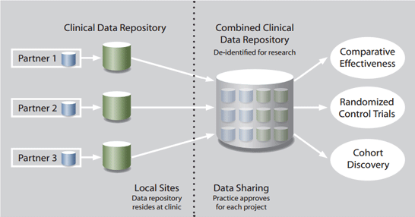
Where Other Universities are Headed
University of Washington:
Data Quest (https://dataquest.iths.org/)
Leaf- Integrates of Regulatory Oversight with Data Accession
De-identified prep to research
PHI access
TriNetX
Attract Industry-Sponsored Trials
Peer-institution Collaborations
University of Michigan
EMERSE (Electronic Medical Records Search Engine; http://project-emerse.org/)
Google for your free text EMR documents and notes
Similar to natural language processing (NLP)
Notes:
Also mention GIS capabilities and surveillance

Slide 19
HSC DATA TYPES
Patient Data
Inpatient/Meditech
Outpatient/Centricity
Dozens of departmental sources
Billing and Claims Data
Biomedical Research Data
Employee Data
Administrative Cost Data
Student Data
Notes:
Growing data enterprise
Data integration is an important subject for our clinical operations and our research enterprise as we continue to evolve our methods for integrating data across our two largest data streams: clinic EMR and hospital EMR.
Two notable informatics tools have been developed to tackle this challenge: A CDW for quality improvement evaluations and research and through a partnership with the non-profit org MyHealth and OU’s Dept of Med Informatics in Tulsa, an HIE to facilitate point of care, data informed decision-making not only at OU but across the entire state.

Slide 20
HSC DATA ENTERPRISE
Prairie Outpost Clinical Data Warehouse (contact: Ashley Thumann)
Integrates patient data from dozens of sources which include Centricity and MediTech
REDCap (contact: Thomas Wilson, Pravina Kota)
Management tool that can be used for Big & Small data
Outpatient EMR: GE Centricity (contact: Matthew Atkins)
Inpatient EMR: MEDITECH (contact: Allen Smith)
MyHealth Access Network, Health Information Exchange System (contact: David Kendrick)
Integrates data from 4,000+ providers and 3+ million patients from all other the state of Oklahoma
Biospecimen repository (contact: OSCTR)
OK-INBRE Bioinformatics (contact: Dave Dyer)
Laboratory for Molecular Biology and Cytometry Research (contact: Allison Gillaspy)
IT Data Services (contacts: Jeff Wall, Melissa Nestor)
Notes:
Clinic + Hospital data: Clinic records from 2007 to present covering 1.3+ million unique clinic patients
Hospital records from 1995 to present approaching 1 million unique patients
Combined clinical and hospital visits of 41+ million
Growing data enterprise
Data integration is an important subject for our clinical operations and our research enterprise as we continue to evolve our methods for integrating data across our two largest data streams: clinic EMR and hospital EMR.
Two notable informatics tools have been developed to tackle this challenge: A CDW for quality improvement evaluations and research and through a partnership with the non-profit org MyHealth and OU’s Dept of Med Informatics in Tulsa, an HIE to facilitate point of care, data informed decision-making not only at OU but across the entire state.
Nestor’s group does the following:
Getting access to Tools
Helping with Power BI
Introducing User Groups
Assisting in the Creation of Reports, Dashboards, and Visualizations

Slide 21
OUHSC IT Resources & Tools
Getting access to data tools
Helping with Power BI
Introducing User Groups
Assisting in the Creation of Reports, Dashboards, and Visualizations
Contact Melissa Nestor (melissa-nestor@ouhsc.edu)

Slide 22
Clinical Data Warehouse Example
Beasley covers POPS patient discovery and recruitment tool

Slide 23
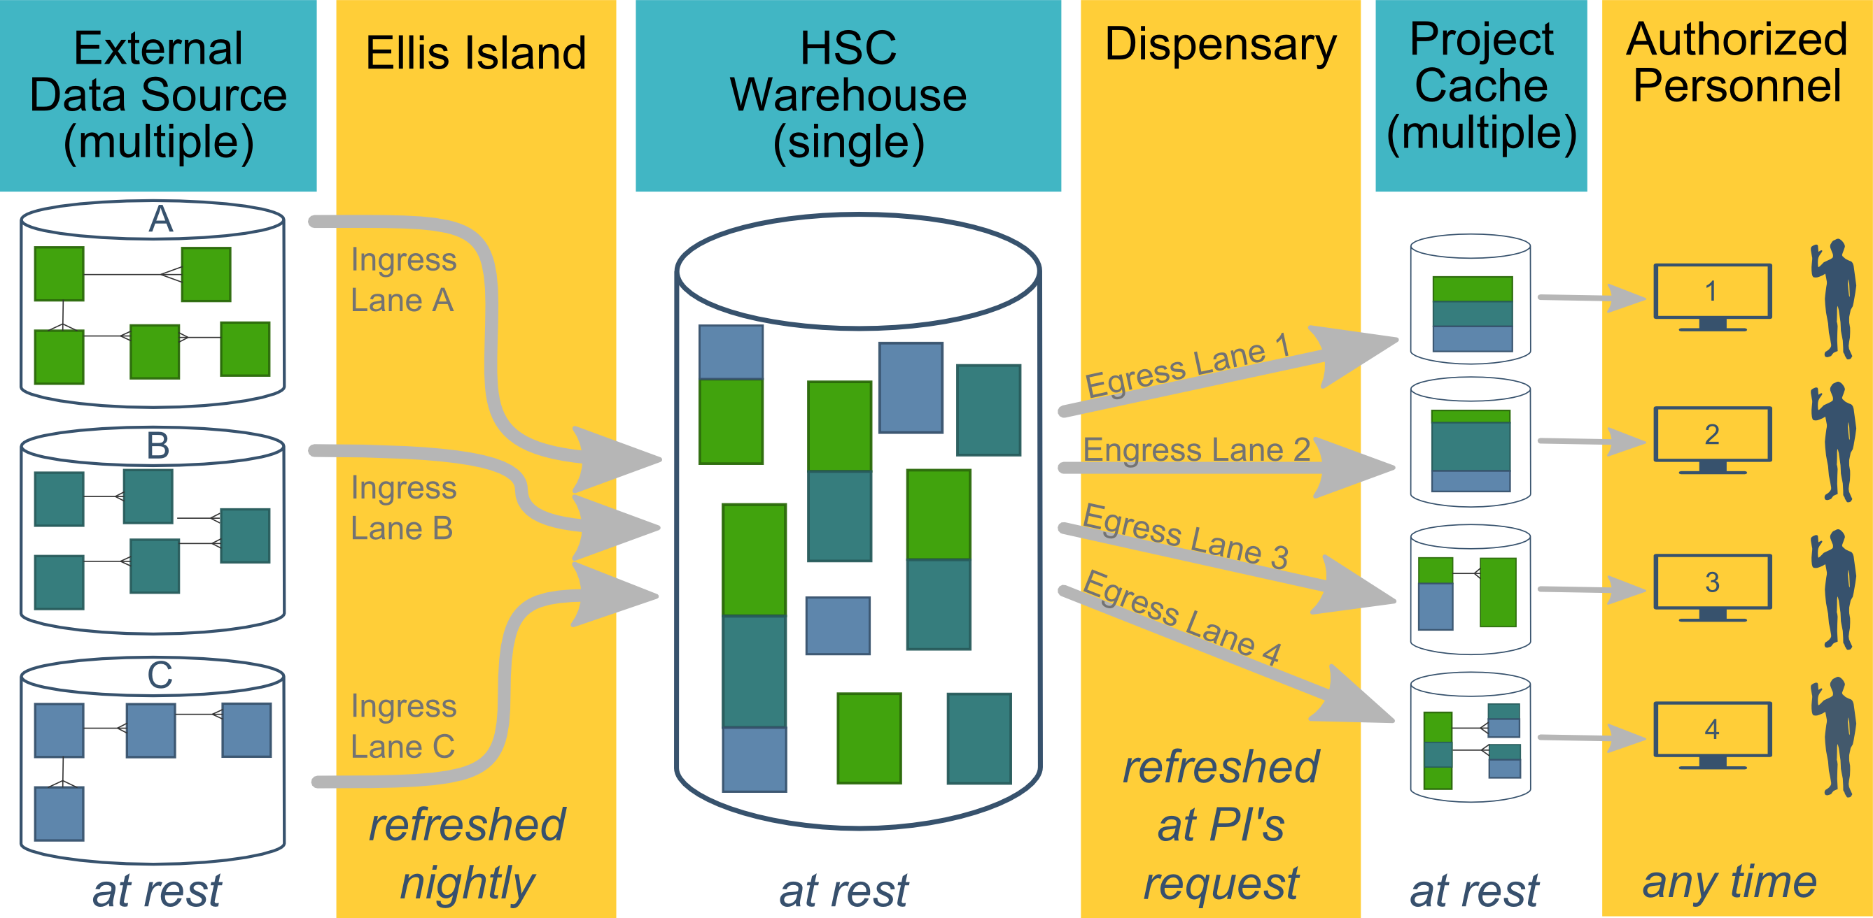
Ecosystem Architecture
Data Source (column 1): contains unique info
Warehouse (column 3): contains copy after manipulation
Project Cache (column 5): contains copy of copy after a lot of manipulation
Notes:
The entire ecosystem can be represented by these six columns. The EMR and other collection databases sit in the 1st column and feed the warehouse in the third. This movement is automated. Inside the warehouse, the info from the different sources are combined. Different patients can be placed in the same table. Perhaps more importantly, records for a single patient that are scattered across different sources are linked.
When a investigation is approved by the IRB, we can develop a tiny database in REDCap that contains the dataset needed for their analysis (5th column). There are a few reasons why REDCap is preferred. First, it’s more secure and scalable than distributing loose Excel files. Second, REDCap has a lot of momentum and adoption, so it’s become familiar to a lot of people on campus. The same software system the clinical researcher learned (for example) for randomized trials is leverage here for these observational studies. Although the research/QA methodology is very different, the software is the same. We expect this familiarity to grow on campus, especially as systems like Qualtrics become less available.

Slide 24
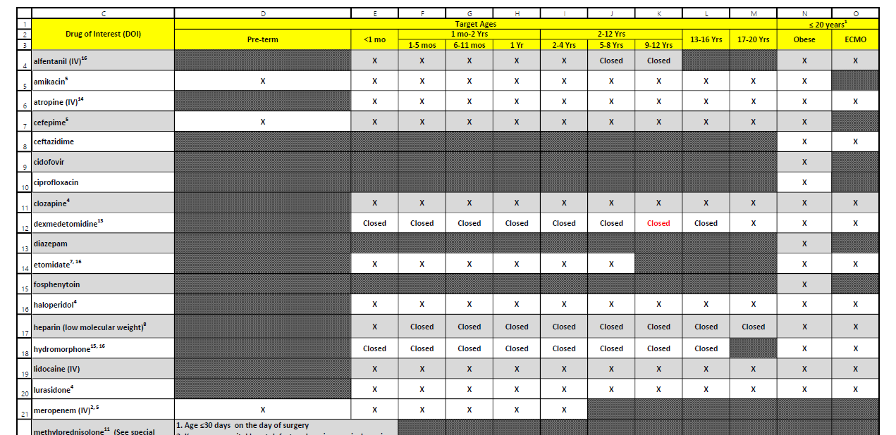
POPS: Pharmacokinetics of Understudied Drugs Administered to Children per Standard of Care
Primary Aim: Evaluate the PK of understudied drugs currently being administered to children
This study is part of the Oklahoma Pediatric Clinical Trial Network (OPCTN), which is a site for the NIH-funded ECHO IDeA States Pediatric Clinical Trials Network (ISPCTN), which is involved with OSCTR (Oklahoma Shared Clinical Translational Resources).
Enrollment Criteria: Child must be receiving an understudied drug of interest (DOIs) per standard of care as prescribed by their treating caregiver, and meet an age range or condition (pre-term, obese, or on ECMO) open for enrollment.

Slide 25
Resource Efficiency: fewer patients, quicker review, less redundancy
2019-01-12 Meditech Extract
Finds patients who received a drug of interest
109 unique patients
Record review: ~15 min/pt
~1,635 minutes
2019-01-13 Meditech Extract
112 unique patients (forgets yesterday)
2019-01-12 Eligibility Report
Finds patients who received a drug of interest and meet an age range or condition currently open for enrollment
31 unique patients
Record review: ~5 min/pt
~155 minutes
2019-01-13 Eligibility Report
6 new patients (remembers yesterday)

Slide 26
Benefits of 20x Efficiency
Better efficiency allows us to spin and cover a larger web. (We should probably transition to the term “filter”.)
Instead of focusing on a subset of dx & location, our report covers the entire space.
We try to aggressively
Cover the entire space
Prune known ineligible cases (ie, Cut from 113 to 31 to 6 unique inpatients)

Slide 27
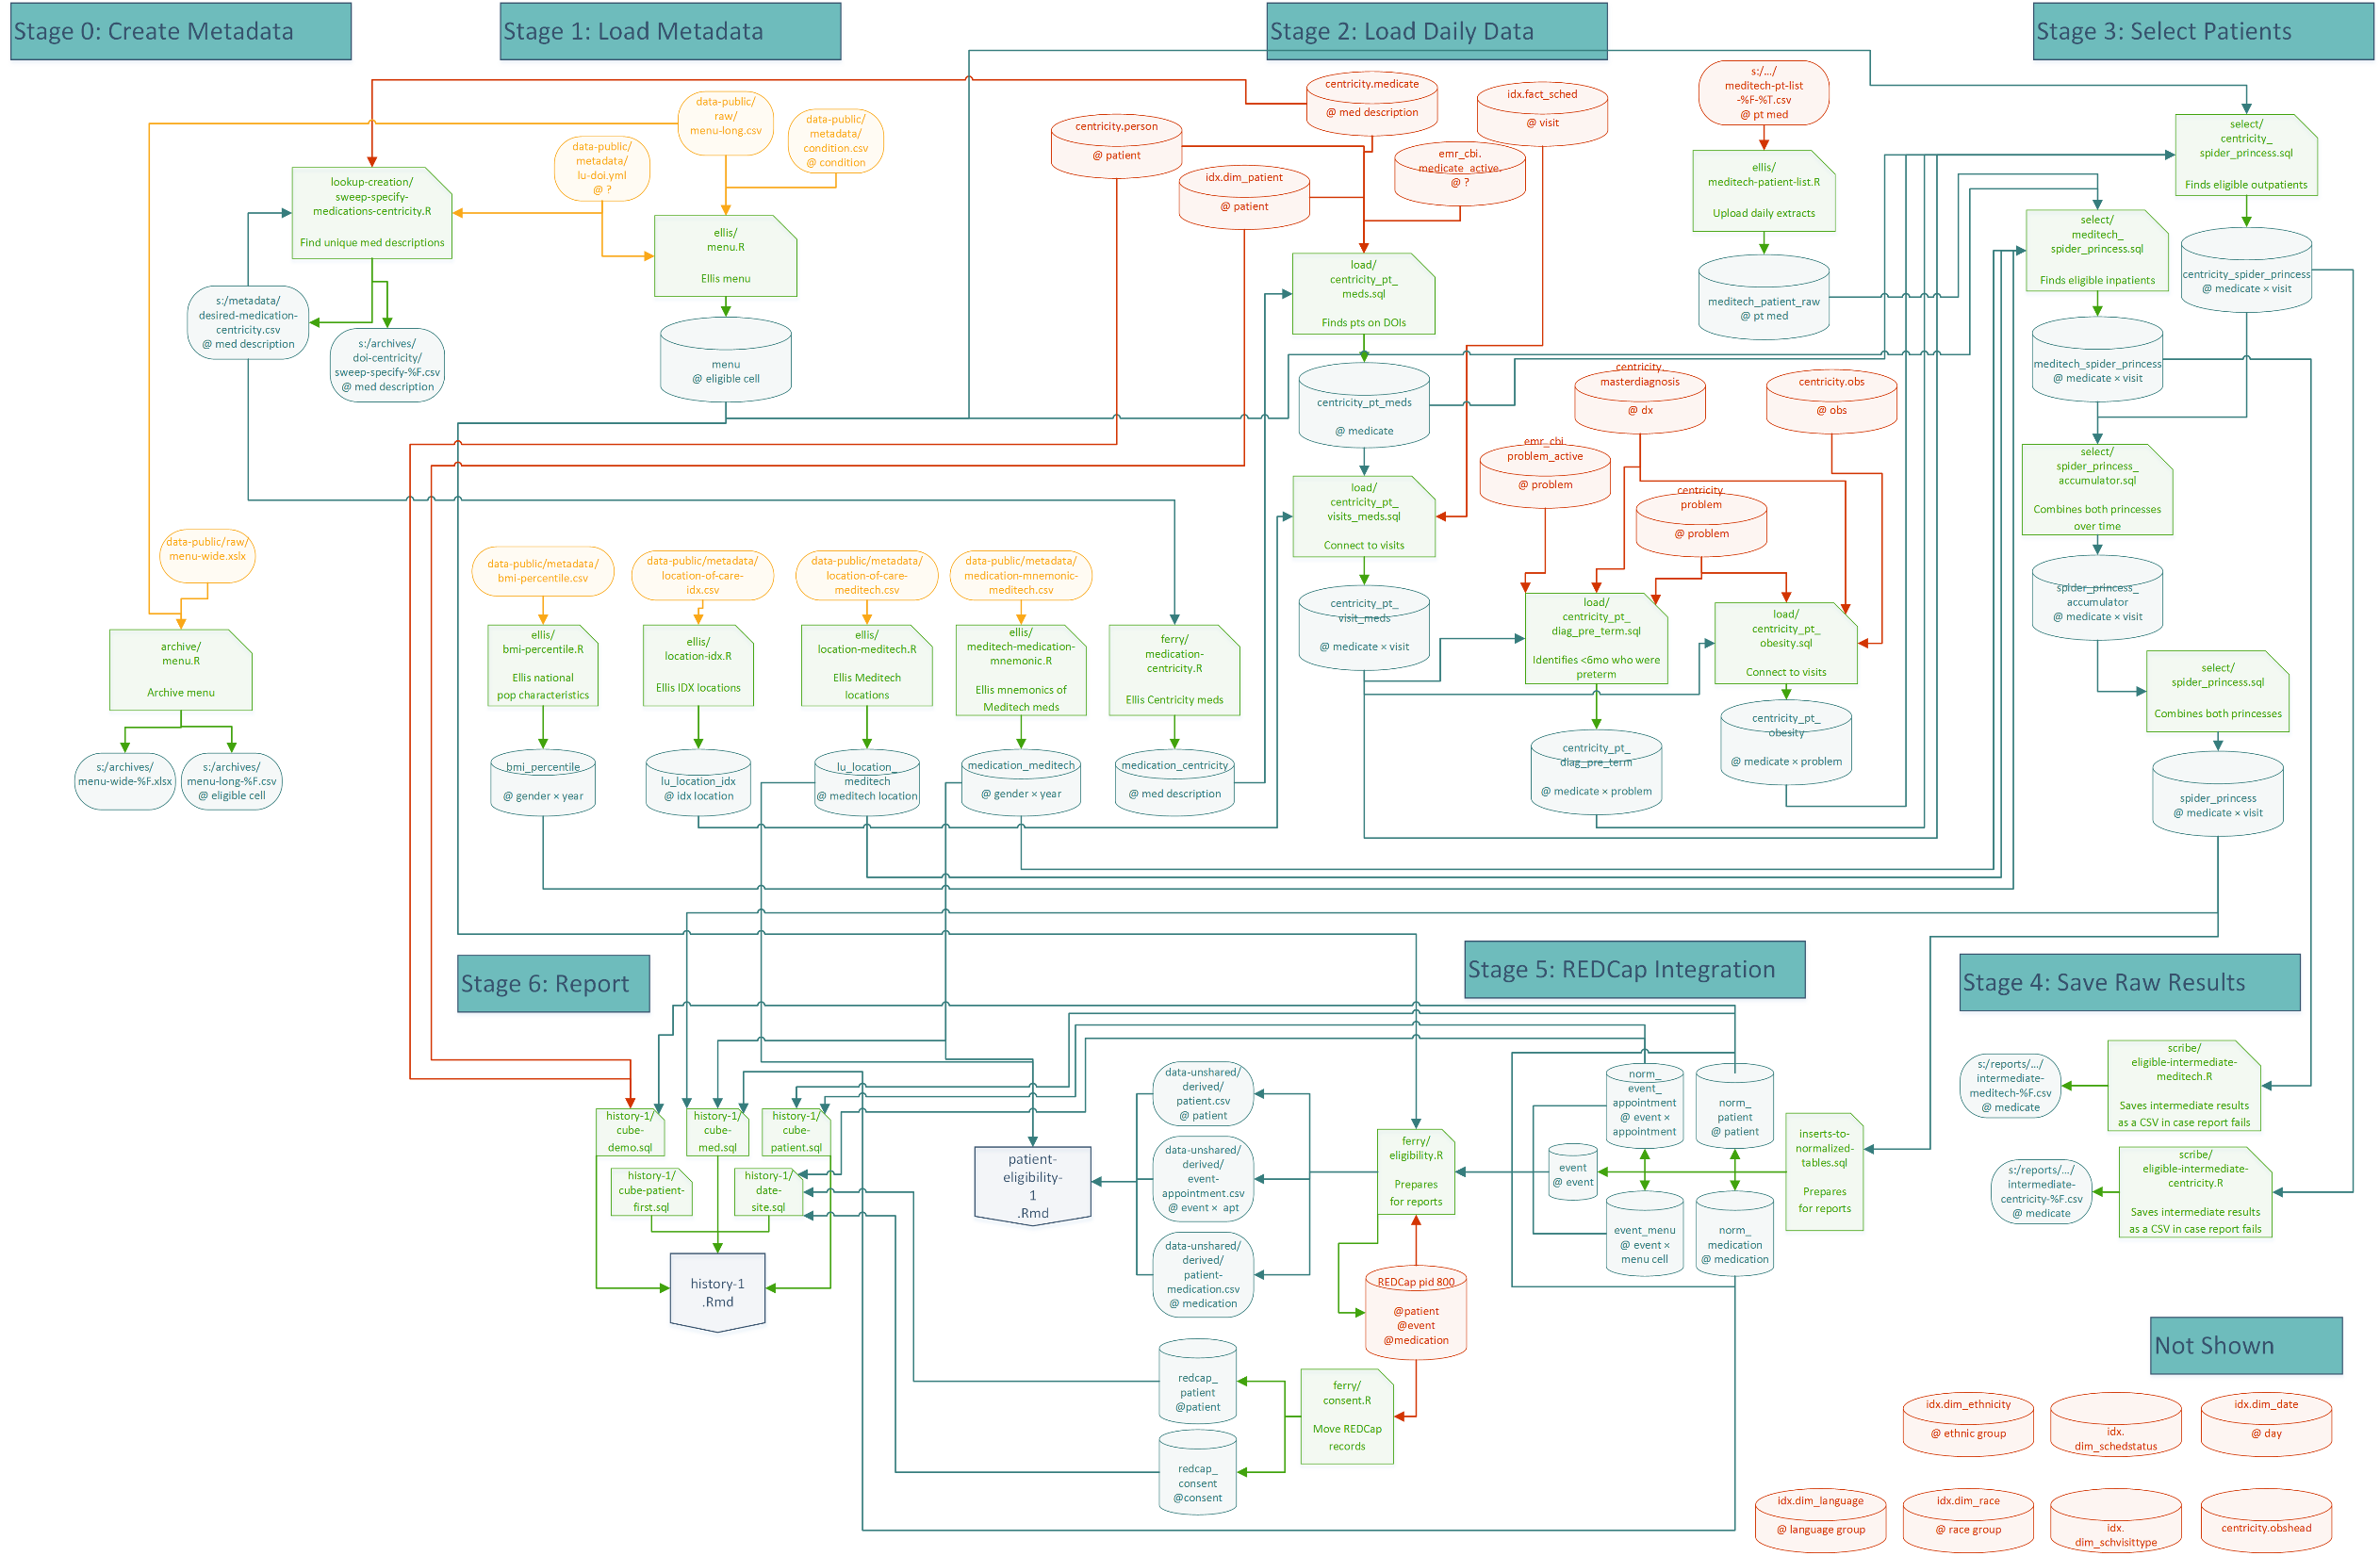

Slide 28
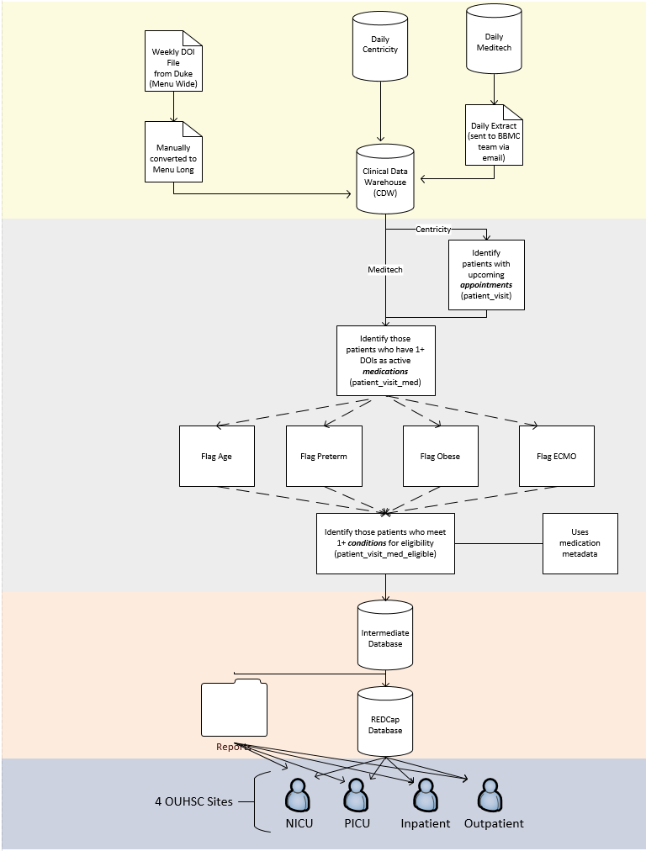

Slide 29
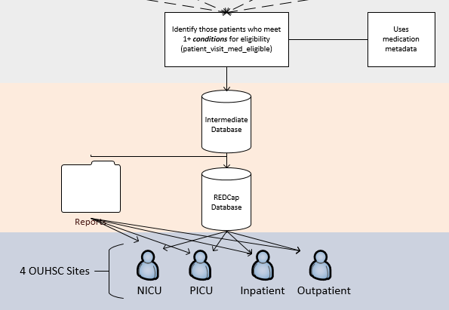

Slide 30
3½ External Data Sources
Centricity (Outpatient) from OU Physicians
Meditech (NICU, PICU, Inpatient) from OU Medicine
Drugs of Interest (DOI) File from Off-site PI (ie, Duke)
REDCap project that records patient’s POPS history
Approached
Consent & Assent
Accepted, Declined, or Deferred date

Slide 31
Outpatient Centricity Data
Process:
Identify patients who have 1 or more DOIs as an active medication
Identify patients with upcoming future appointments (0 - 30 days) in desired locations of care
Flag patient by condition of eligibility (age, preterm, obese, ecmo)
Use R & SQL to
transfer data to database and REDCap
Produce a semi-interactive HTML report saved to a file server
Challenges:
CDW refresh needs to finish within 90 min every morning.
Medication descriptions are free text. Each unique value needs to be manually reviewed for inclusion/exclusion.
Need to refresh eligibility list daily for research staff, but preserve in database for study monitoring/oversight reports.

Slide 32
Inpatient Meditech Data
Process:
Daily extract produced by IT/Reporting in OU Medicine
Ideally: the nightly dataset is saved to a designated file server
Reality: the nightly dataset is emailed to Sree
The brittle pipeline requires a VBA script in Outlook to transfer the csv to the file server
Automatically import the csv dataset into CDW using R
Incorporate with existing data sources
Challenges:
We are mostly unfamiliar with the data structure and variable conventions in Meditech
Matching of patients between Meditech & Centricity.
Medication instructions includes ‘ASDIR’ and ‘PRN’, which may generate false positives on eligibility report.

Slide 33
Weekly Drugs of Interest (DOI) File – Menu Wide
Provided by Duke as PDF and Excel
Specifies:
drugs of interest
route
conditions for eligibility: age, pre-term, obesity, or ecmo
instructions for research staff (footers)
specimen type: CSF, plasma, etc.
enrollment status
This is not in a consistent format and therefore requires manual translation (~20 minutes/week).
The format is adequate for humans, but it’s not for automation.

Slide 34
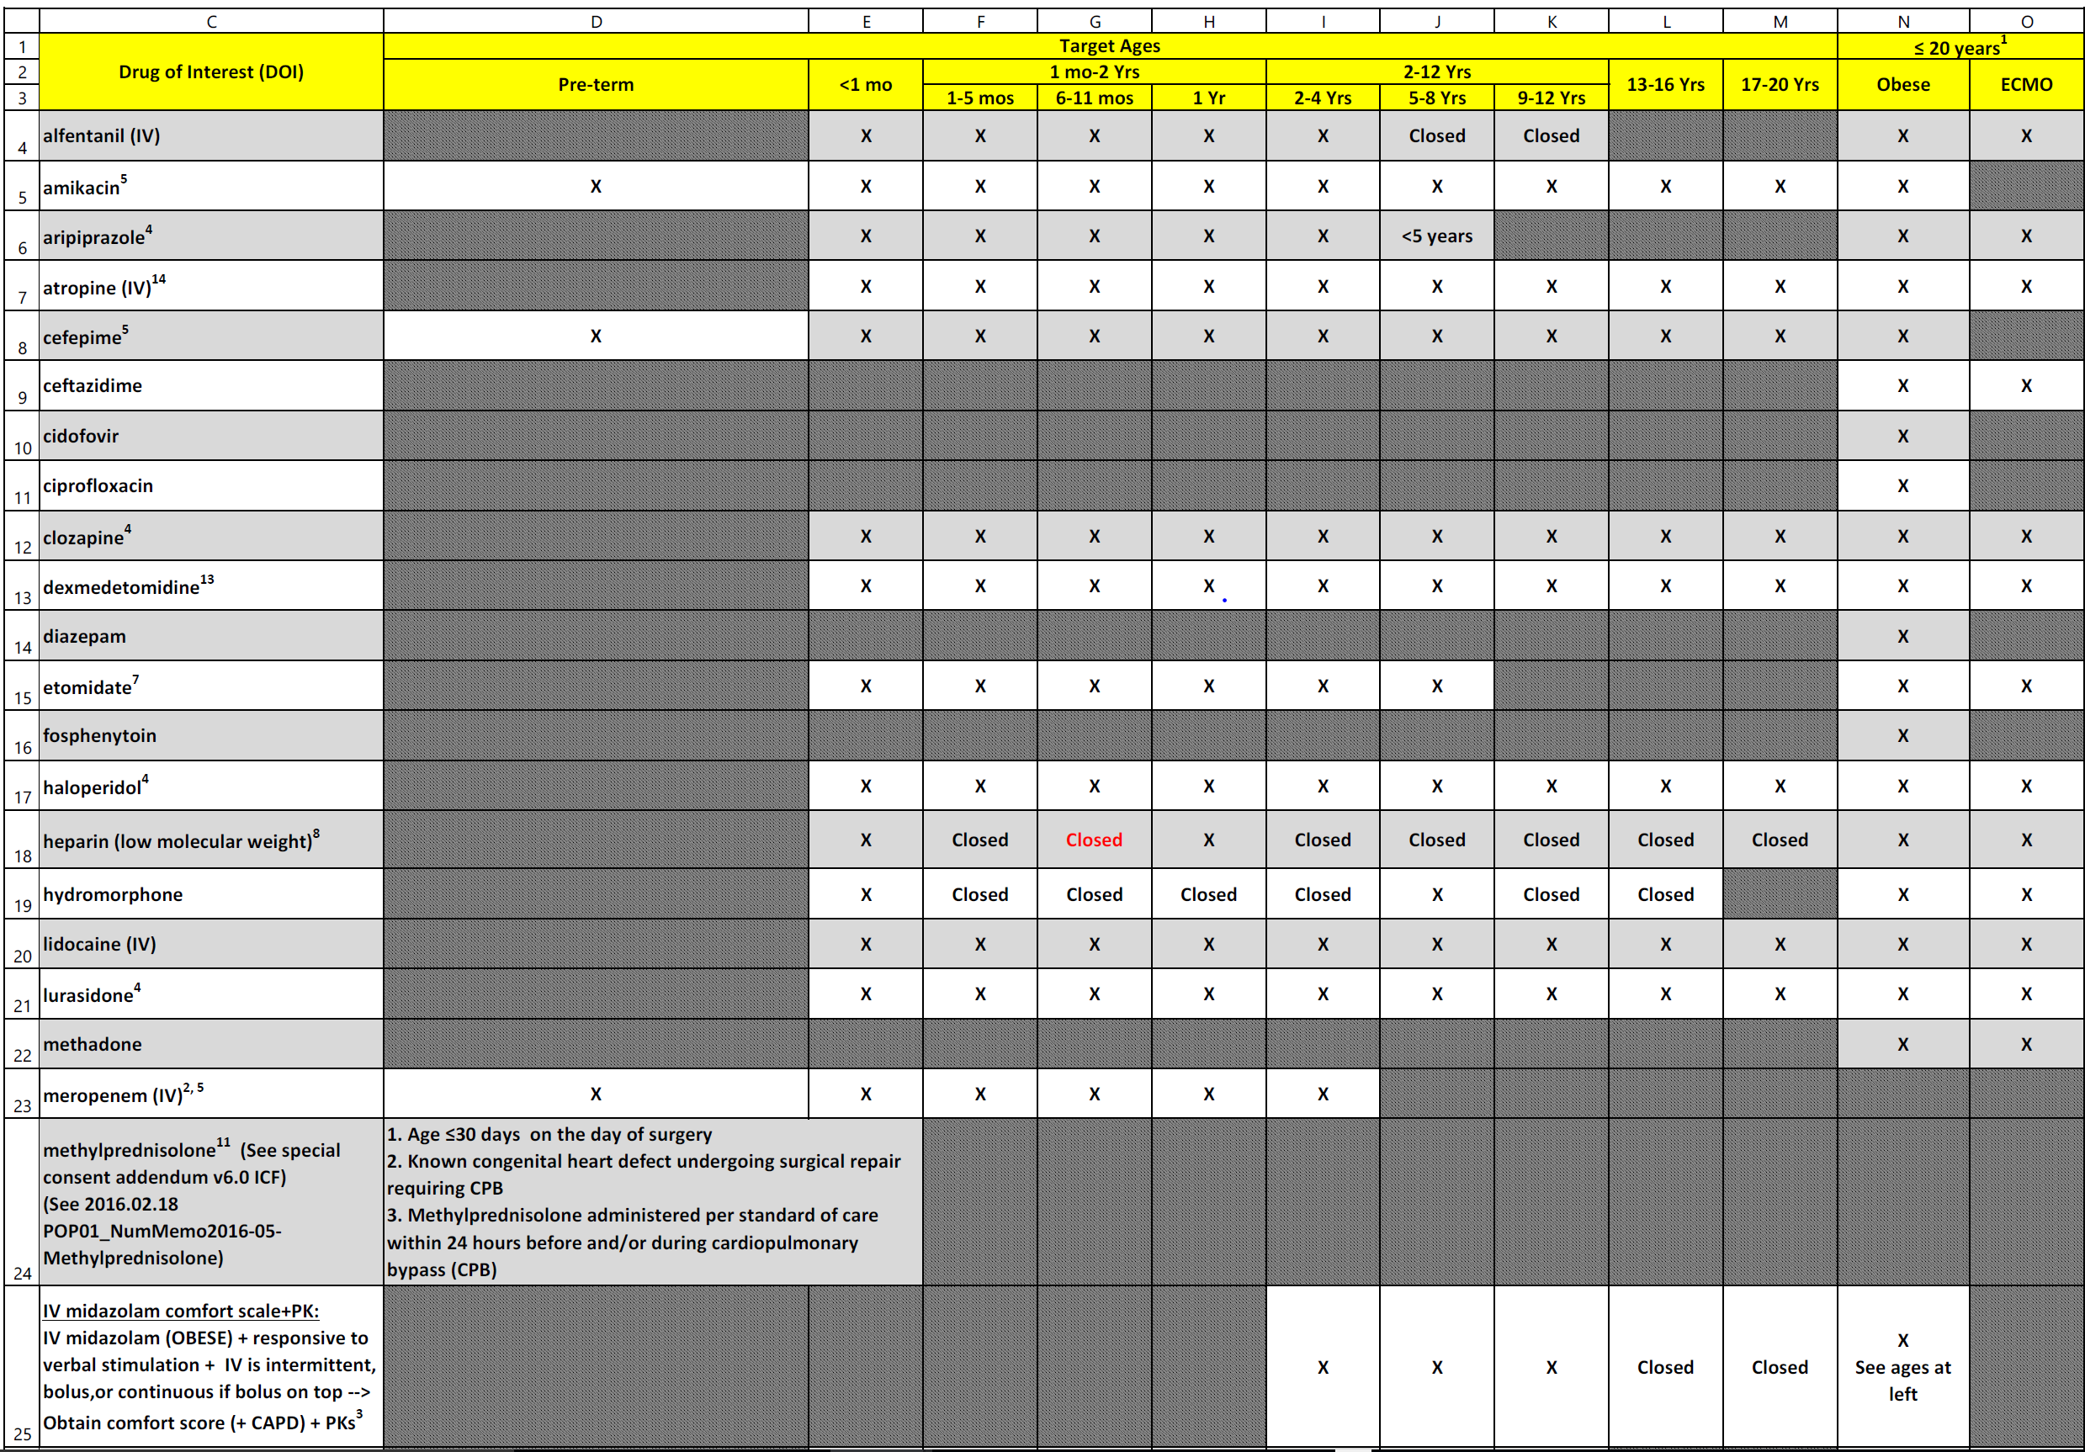

Slide 35
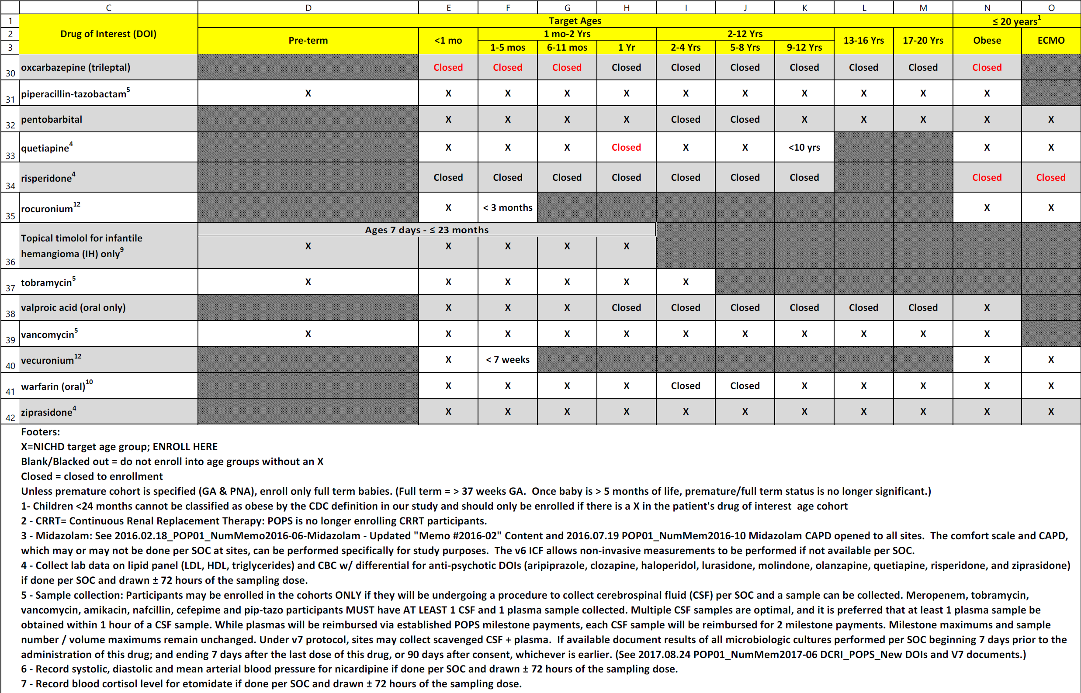

Slide 36
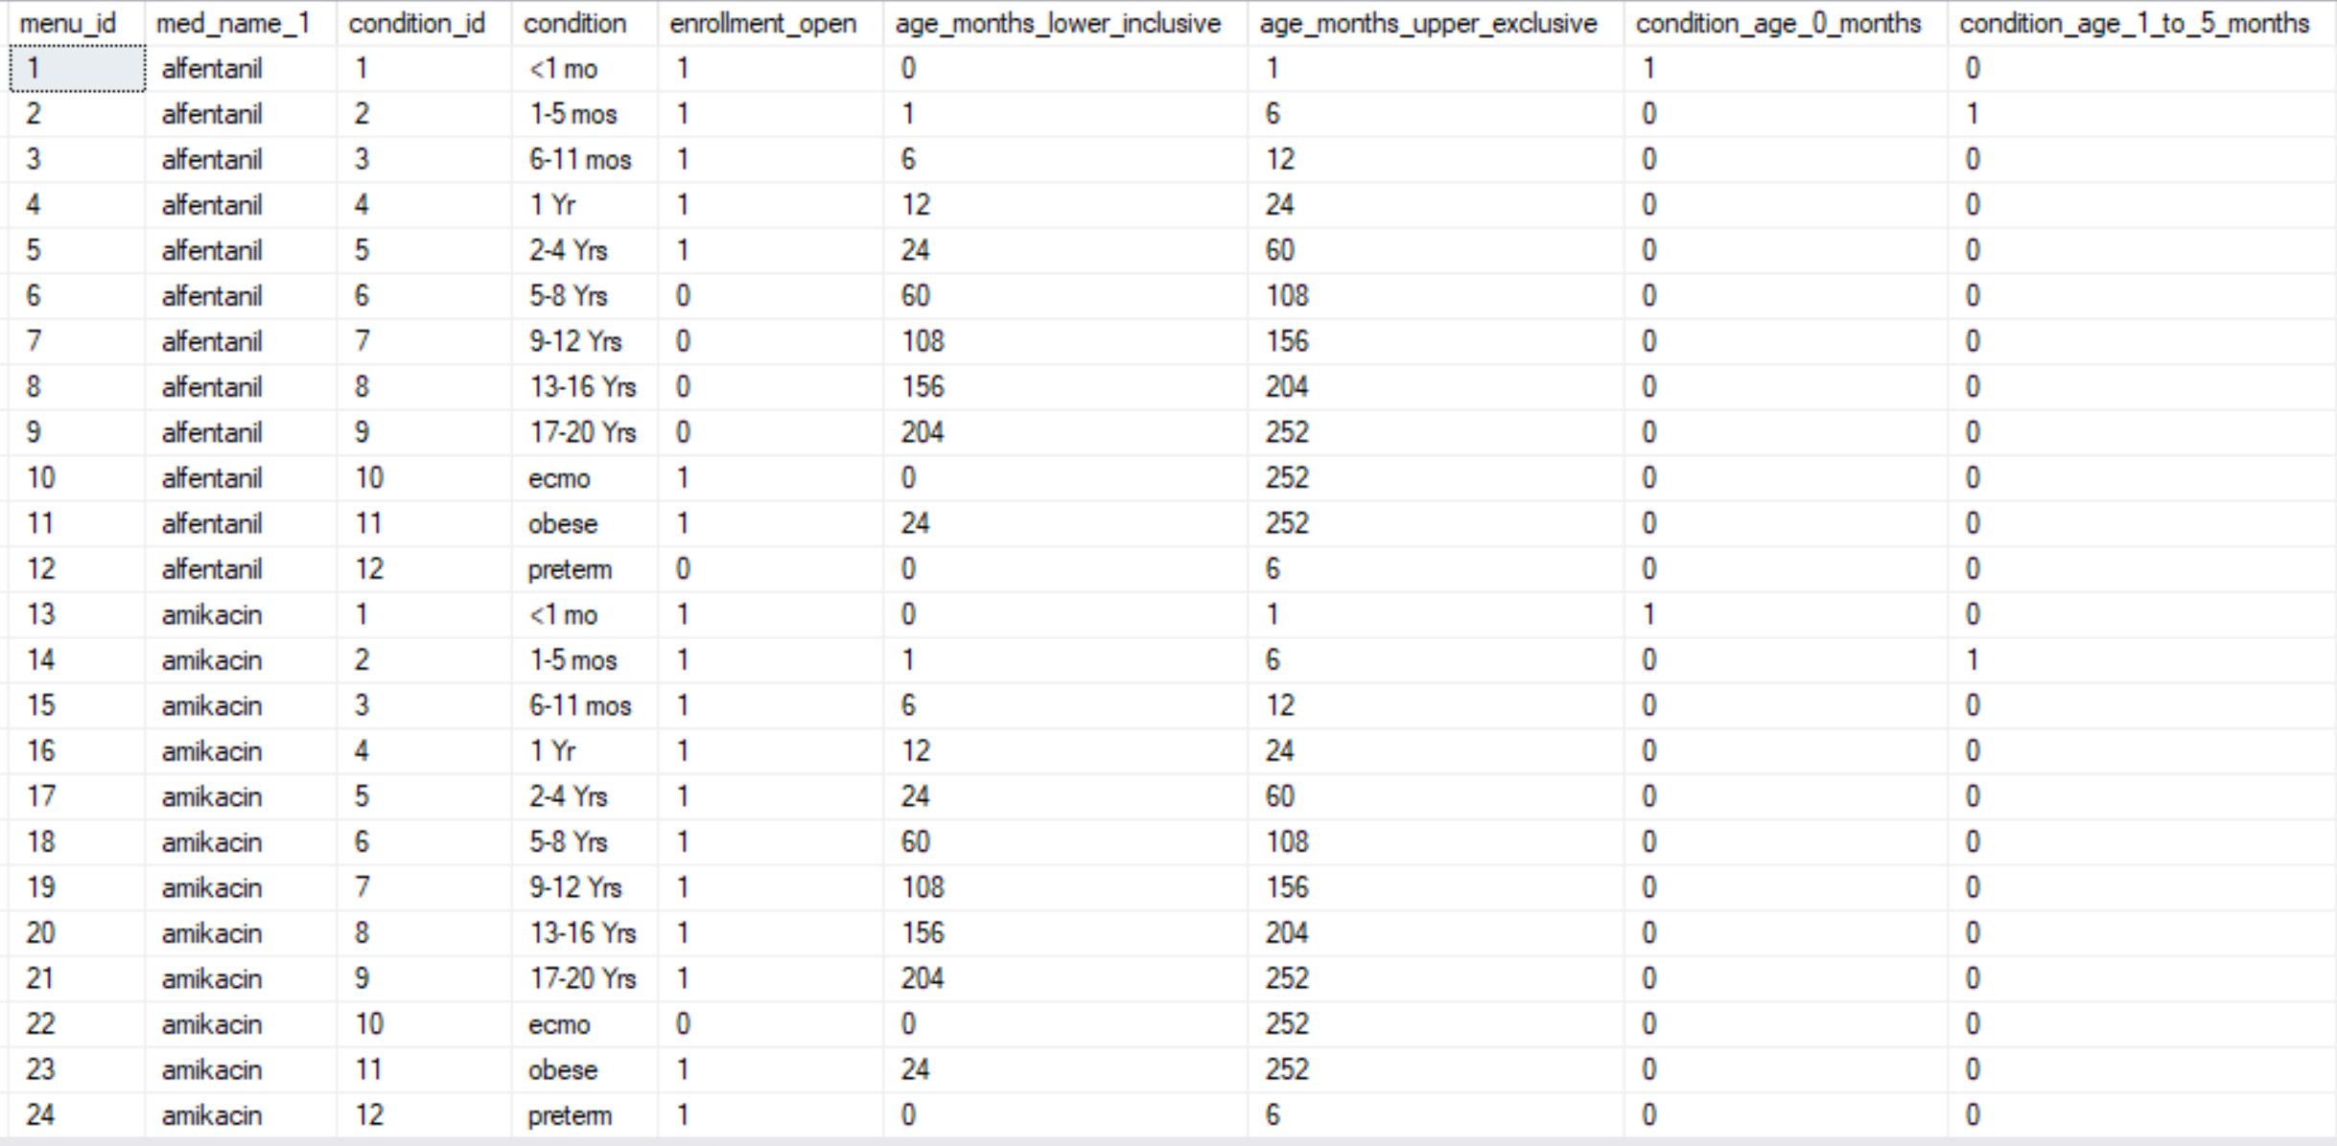
Menu Wide Converted To Menu Long
Reminder: menu wide →
Continues for 10+ columns…

Slide 37
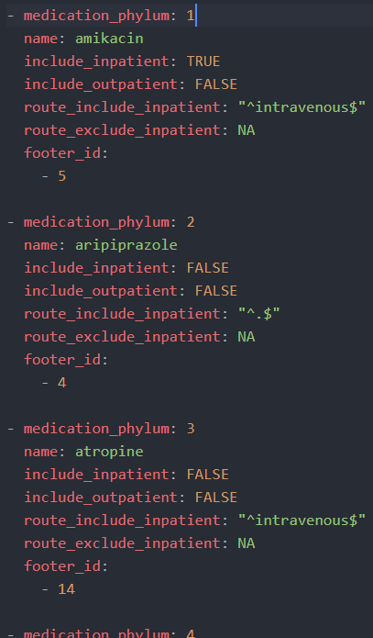
Maintain Metadata Tables
Locations of Care (GECB/IDX Scheduling Locations)
392 unique values in IDX
Use ‘desired’ indicator for inclusion in future appointments query
Meditech’s room/bed values has similar mechanism
Medication Descriptions (Centricity EMR)
Currently, the system isn’t searching for medications where the route is specified on the DOI file as IV.
yaml metadata file
Black-list medications if staff thinks they don’t apply.
Ultimately, clinical decisions must be made by the study investigators. The initial settings are the CDW’s best guess.

Slide 38
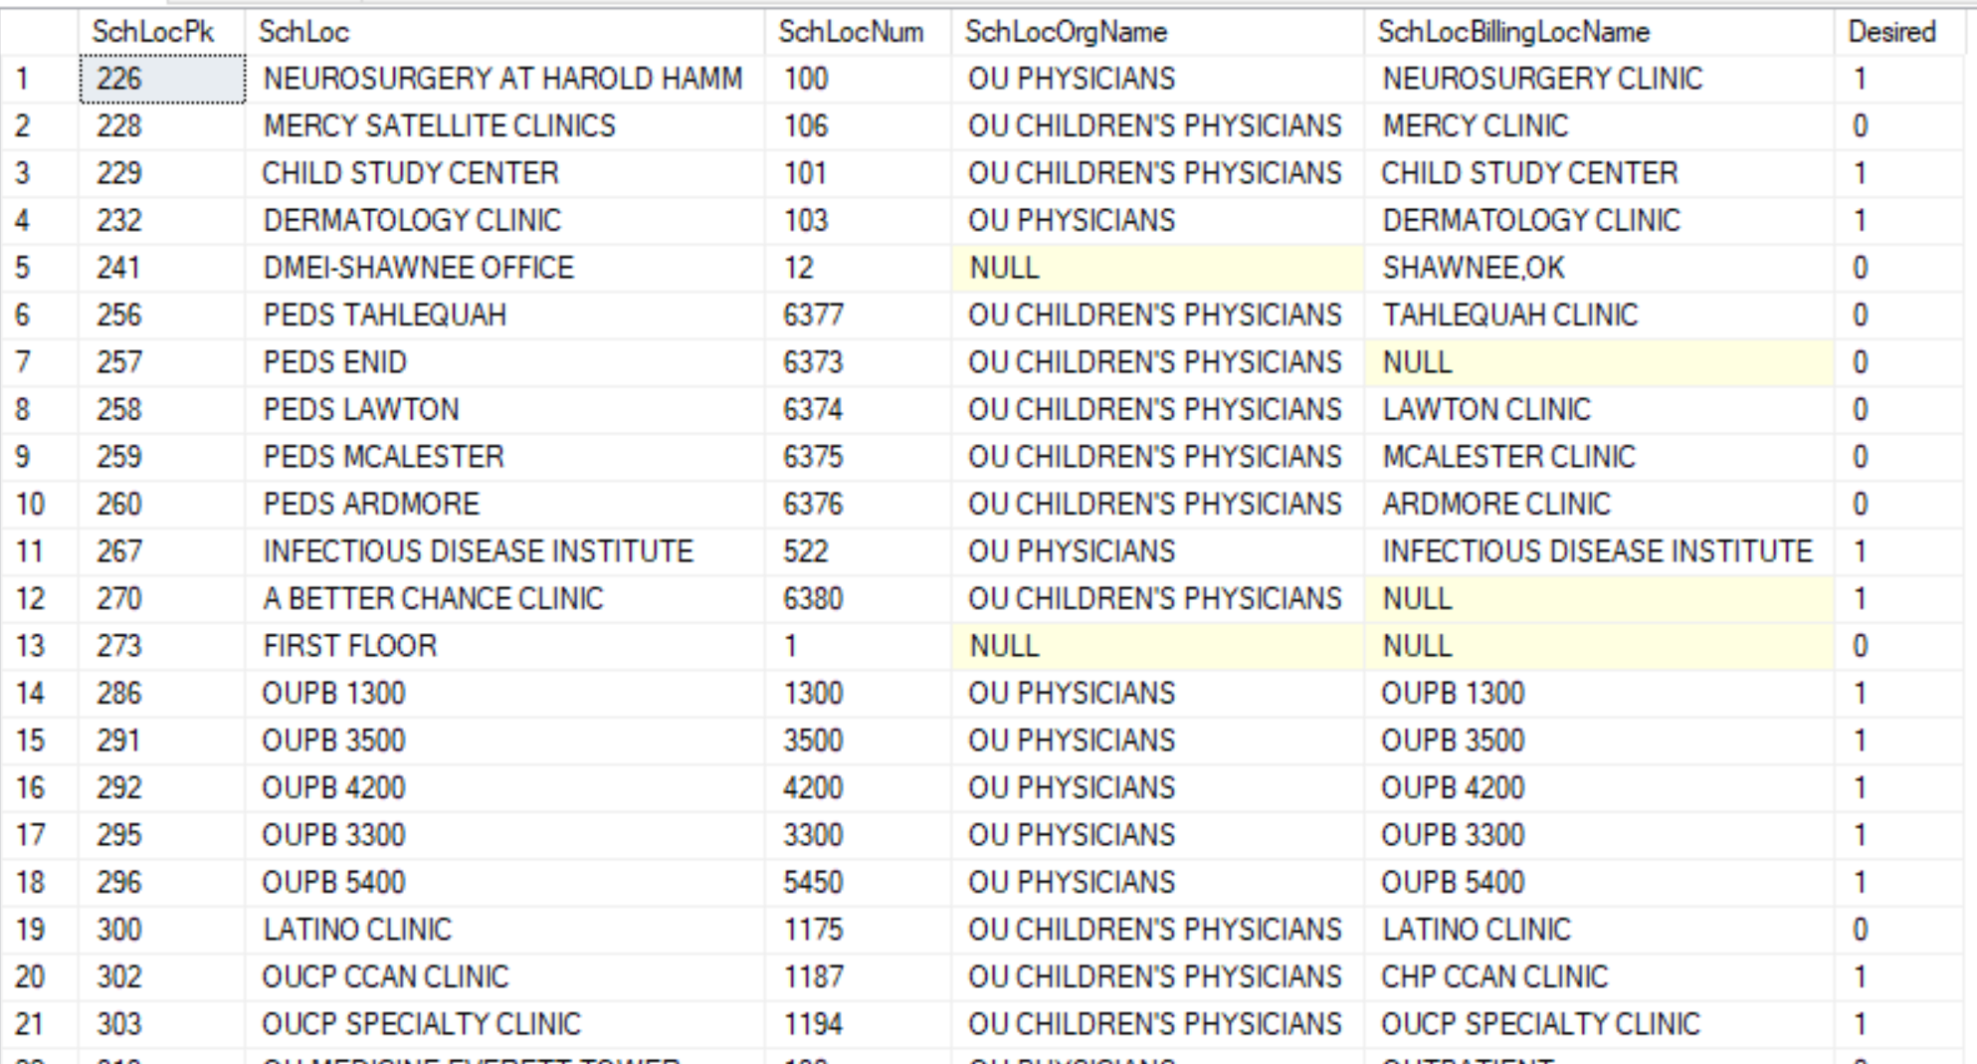
Example of Location of Care Metadata

Slide 39
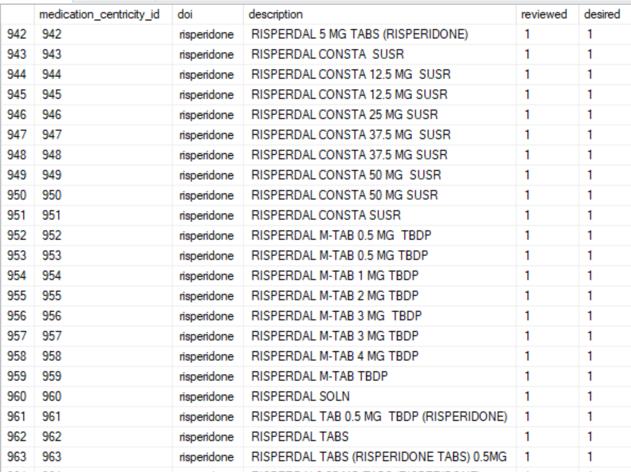
Example of Medication Metadata (Centricity)
Maps to 600+ entries in Centricity’s MEDICATE table
Maps to Menu-wide

Slide 40
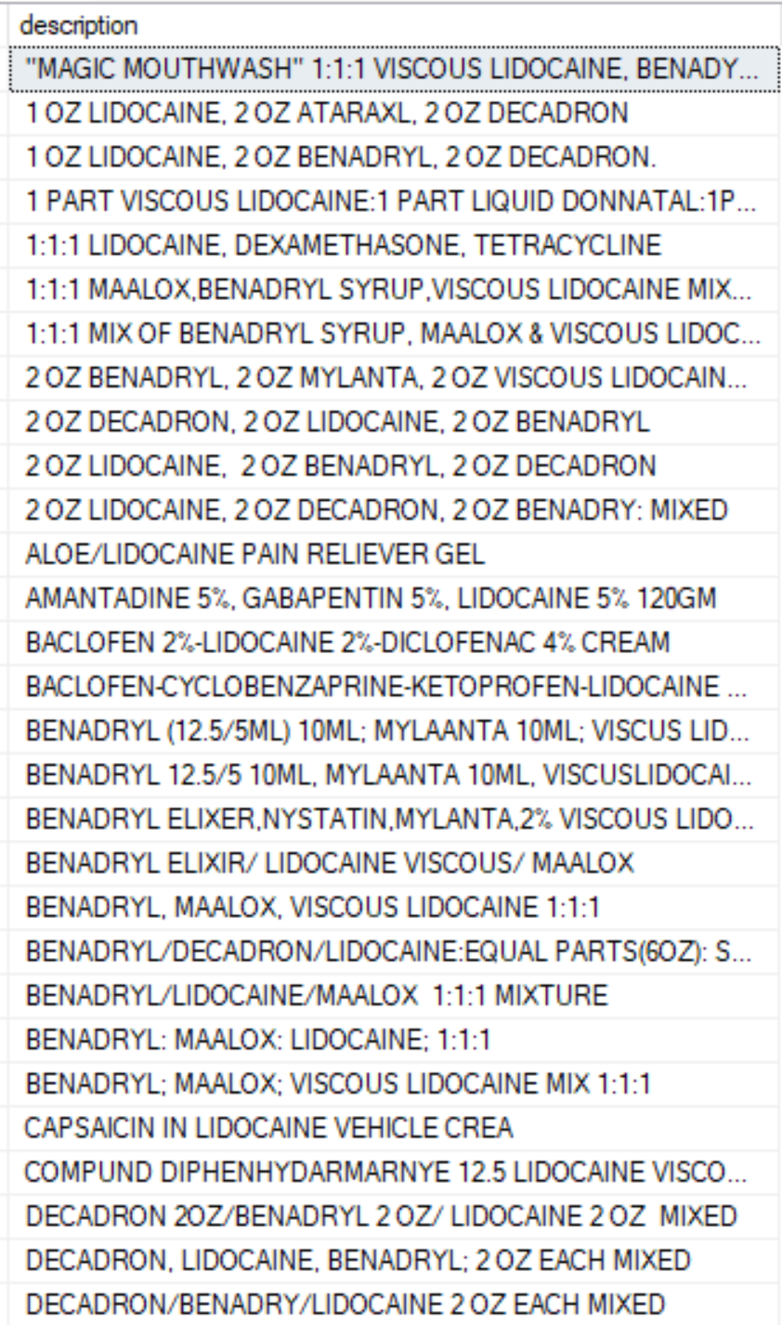
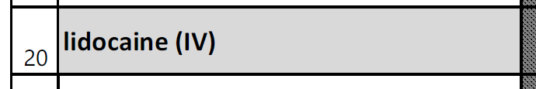
Lidocaine Example
DOI file specifies route as IV.
Route, strength, and formulary are included as a part of medication description in Centricity’s MEDICATE table.
There are currently 691 variations matching ‘lidocaine’.
None appear to specify the route as IV.

Slide 41
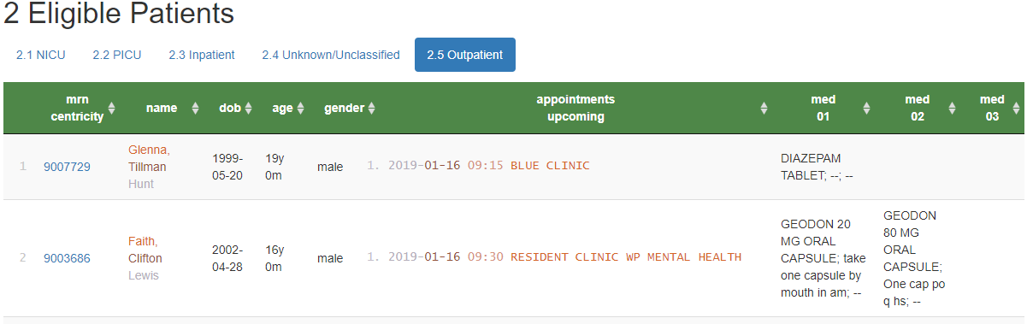
Outpatient Eligibility Reports
Shows upcoming appointments of potentially eligible patients
Location of care (from IDX)
Date & time (from IDX)
Qualifying medication (from Centricity; e.g., Diazepam)
Qualifying condition (from Centricity; e.g., ECMO, 24 months old)
Similar inpatient process was developed
Eligible Patients for POPS

Slide 42
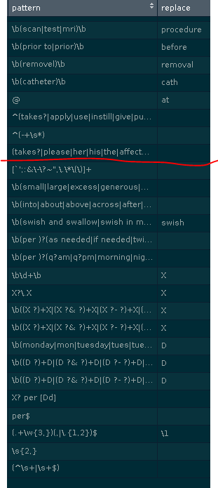
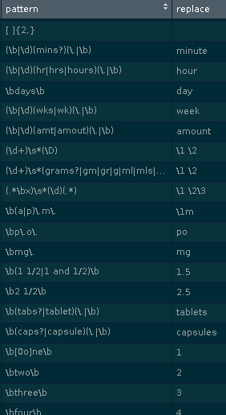
Collapsing/Standardizing Med Instructions
Use regular expressions to match free-text, and replaces with a ‘better’ value.
Correct misspellings
Remove junk
Standardize format (eg, space between `5mg`)
Standardize term (eg, `cap`, `caps`, &`capsule` to capsules`)
Remove info irrelevant to eligibility below the red line (eg, `1mg` and `2mg` becomes `X mg`)
Reduces 130k entries to 46k

Slide 43
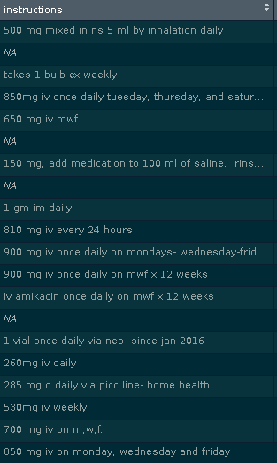
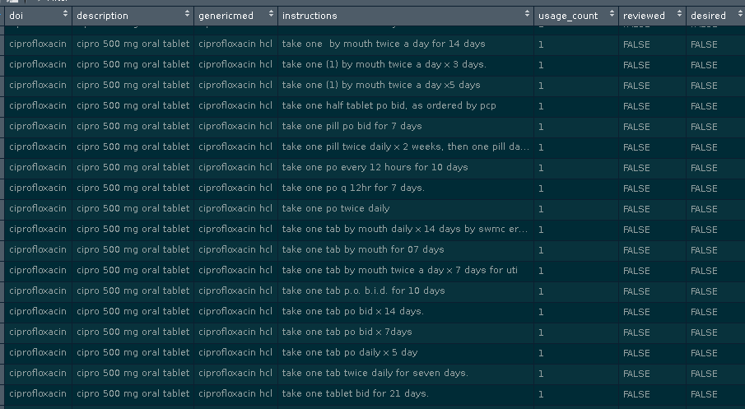
Collapsing/Standardizing Med Instructions

Slide 44
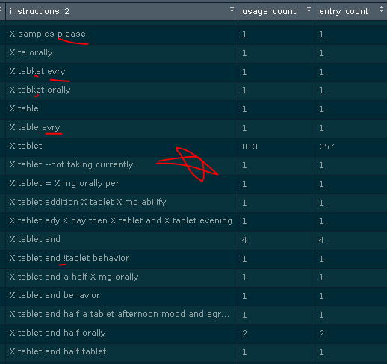
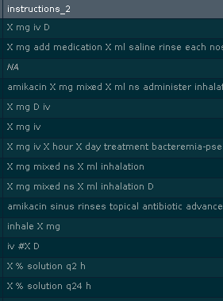
Collapsing/Standardizing Med Instructions

Slide 45
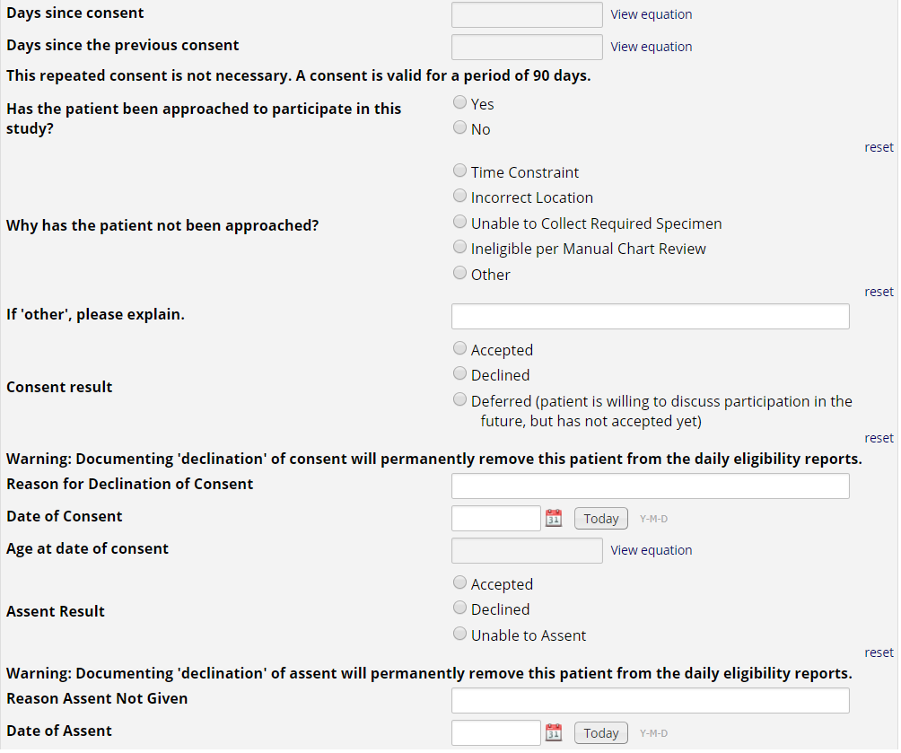
REDCap Project
Research nurses use the MRN hyperlink on the eligibility report to document approached/consent/assent in REDCap.
If a patient or guardians ‘declines’ consent or assent, the patient is removed from future eligibility reports.
This also allows us to create summary stats for the investigators to monitor progress, address issues with resource allocation, etc.

Slide 46
Eligibility Report & History Report
Demo

Slide 47
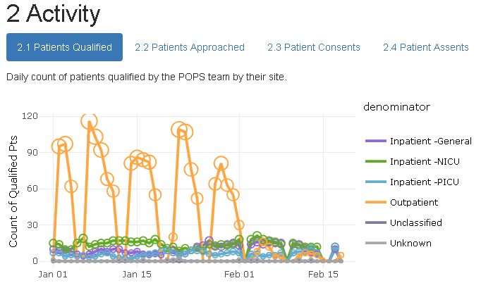
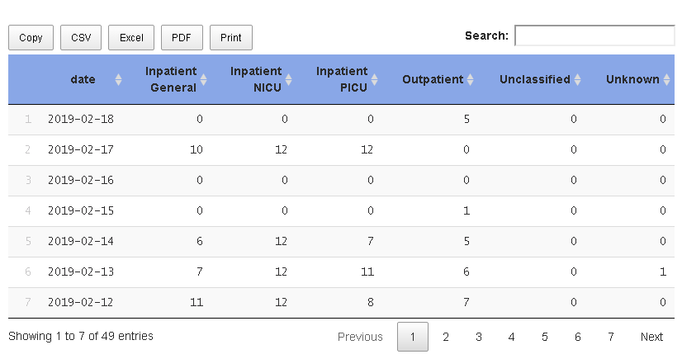
History Report
All patients in the database system
Stage 0a: Centricity
Stage 0b: Meditech
Eligible: selected by the algorithm. (Internally, this is called the spider princess.)
Qualified: eligibility is confirmed by chart review.
Approached: study personnel talks to patient or family
Consented: parents agree (or 18+yo patient agrees)
Assented: child patient agrees (7-17 yo)
Enrolled (per drug; 1+ specimen)
Completed (per drug; all possible specimens)

Slide 48
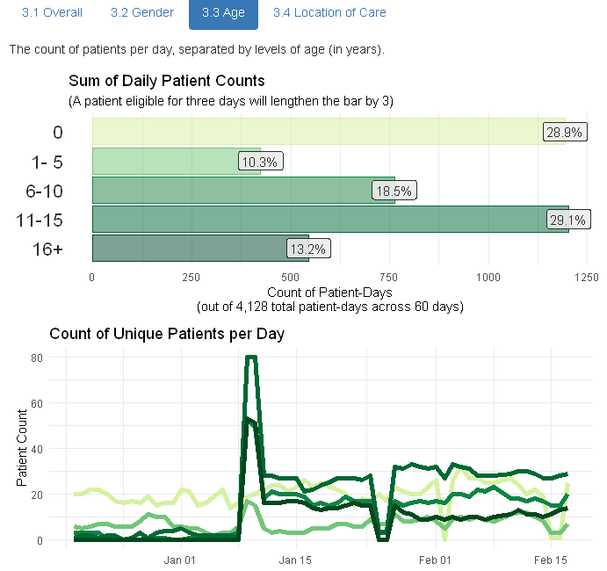
History Report
Spaghetti plot of pt over time
Overall
Gender
Age
Location

Slide 49
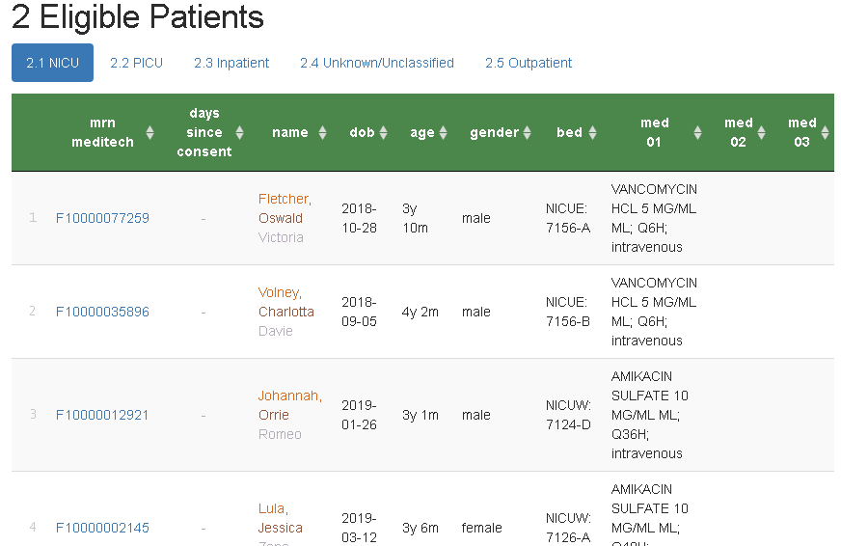
Eligibility Report
Hyperlinks to REDCap
Consent stop watch
Filter, search, & sort

Slide 50
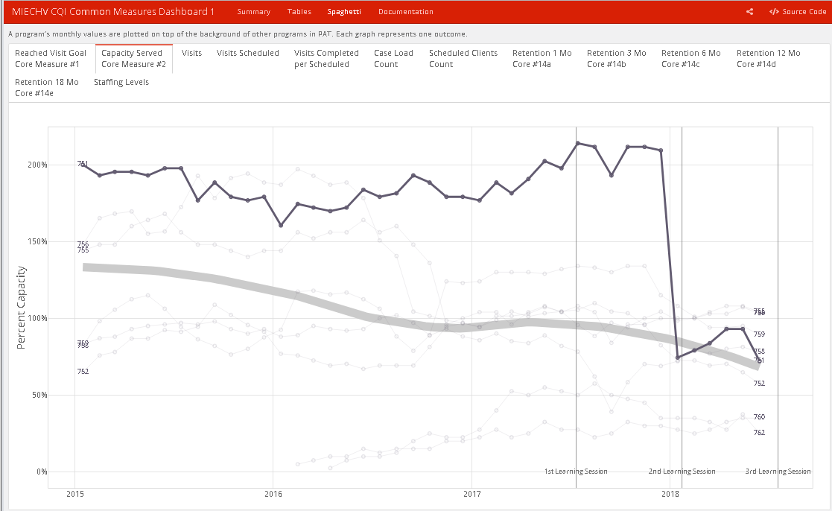
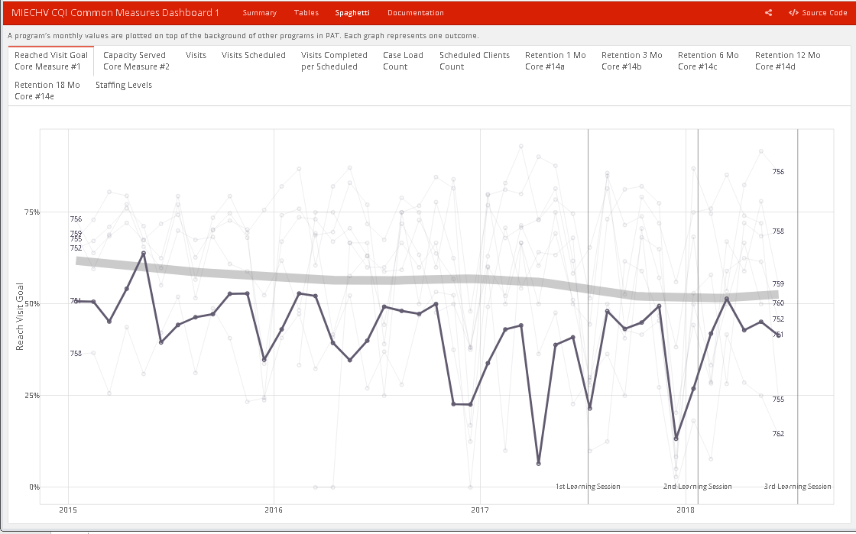
Future Feedback to Research Staff
In a 5+ year state-wide Health Dept project, we build dashboards for each site.
Each dashboard addresses a mini-CQI project they create.
Typically the CQI quantifies pt falling through the cracks
Dropping out of program
Droughts of visits
Noncompliance of model

Slide 51
Future Feedback to Research Staff
Could identify segments falling through the POPS recruitment cracks
Meds
Age & condition
Location
When do they drop from the pipeline?
Eligible
Qualified
Approached
Consented
Assented
Enrolled
Completed

Slide 52
Job Ad: we’re hiring
Data Management Analyst II - Job Number: 190895
https://ou.taleo.net/careersection/2/ jobdetail.ftl?job=190895

Slide 53
REDCap Project
REDCap is well-suited for many types of medical research, but big data isn’t one of them.
We routinely have studies containing 100k records, but not millions or billions.
However its user interface can augment conventional stores of big data.
Automation can transfer the user-facing elements to and from REDCap from large databases.

Slide 54

REDCap is a secure web application for building and managing online surveys and databases.
While REDCap can be used to collect virtually any type of data (including 21 CFR Part 11, FISMA, and HIPAA-compliant environments), it is specifically geared to support online or offline data capture for research studies and operations.
The REDCap Consortium, a vast support network of collaborators, is composed of thousands of active institutional partners in over one hundred countries who utilize and support REDCap in various ways.
Monthly REDCap discussion meeting (1st Tuesday of every month) and training sessions for OUHSC staff and students.
Contact: Thomas Wilson (Thomas-Wilson@ouhsc.edu)

Slide 55

At OUHSC, there are two instances of REDCap.
BBMC REDCap Instance:
Department of Pediatrics
BBMC Collaborators
Researchers requiring more than the basic “vanilla” REDCap.
DHS Waiver Project (connects multiple REDCap projects together via Dynamic SQL query fields)
MIECHV CQI Project (creating custom reporting dashboards using REDCap’s API functionality)
TF-CBT Project (creating aggregate shiny Web reports using REDCap API)
DHS Waiver Project (complex randomization component)
Contact: Thomas Wilson (Thomas-Wilson@ouhsc.edu)

Slide 56

At OUHSC, there are two instances of REDCap.
Enterprise REDCap Instance:
BERD
COPH
Departments not needing the BBMC instance
Contact: Pravina Kota (Pravina-kota@ouhsc.edu)

Slide 57
REDCap: Comparison
REDCap | Qualtrics
Secure and HIPAA-Compliant Electronic Data Capture Tool | Support for multiple language
Data hosted by OUHSC | Action-based triggers
Mobile device compatible | Mobile device compatible
Programmatic API access | Programmatic API access
Single click de-identification for data export | Robust reporting tools
Data import capabilities | Vendor support
REDCap consortium w/over 2000 institutions worldwide
Longitudinal data collection (scheduling and tracking)
Data quality checking
Intuitive interface
Local training and support offered by BBMC

Slide 58
REDCap Training & Assistance
Training for your department on an “as needed“ basis
Monthly “REDCap Recap” feature presentation and Q & A session
Samis Center OU Children’s Hospital
1st Tuesday of every month @ 10:30 am
E-mail Support
Contact: Thomas-Wilson@ouhsc.edu

Slide 59
REDCap Live Demo
Online Consent Survey
Demographic Form
Concomitant Medication Form
NCI Follow-Up Survey
https://bbmc.ouhsc.edu/redcap/redcap_v8.4.0/index.php?pid=1174

Slide 60
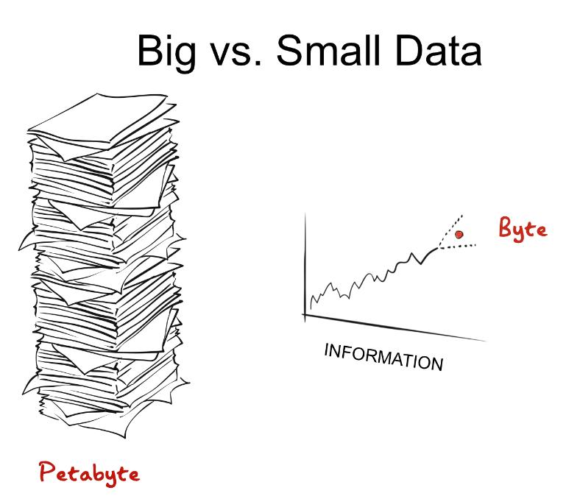
Notes:
If Big Data is good, Bigger Data must be even Better
Adding data = value-added?

Slide 61

Notes:
Although I often champion Big Data’s 3 V’s: volume, velocity, and variety,
Today I intend to play the role of devil’s advocate, asking- can too much harmonizing be a bad thing?
Exploring the answer to this question, I intend to focus on a 4th v: veracity, and whether
stacking more sheets of data bring us any closer to the truth-
I would argue it can but the voyage is long and arduous,
and short cuts along the way will lead us astray, just like those fabled ancient sailors of yester yore

Slide 62

Notes:
The premise of this talk touches upon the age-old quandary: how to strike a balance between quantity and quality

Slide 63
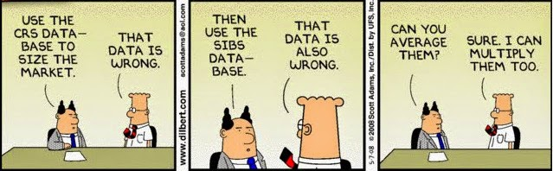
Notes:
Reminded of another Dilbert cartoon where Dilbert is asked to average dirty data to fix inconsistencies and his retort is why not multiply instead

Slide 64
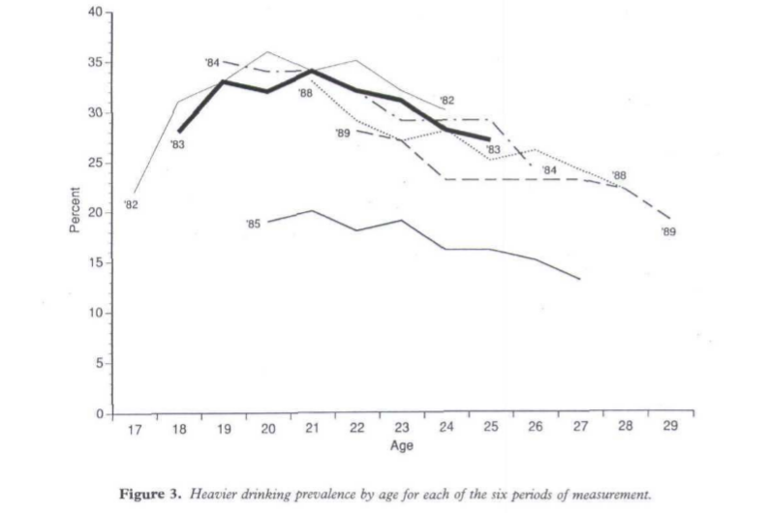
Harford, T.C. (1994) Addiction 89, 421-24
Harford, T. C. (1994). Addiction, 89, 421^24
Notes:
One subtle but powerful example-
US National Longitudinal Survey (NLS) of Labor Market Experience among youths aged 17–24
As a sobering example,6 Harford (1994) found that discrepancies in the order and style of two
items assessing alcohol use at two different periods of time resulted in a large and observable
change in the reported levels of heavy alcohol use. This demonstrates that something as simple
as altering the order of presentation of two items at two points in time can lead to substantial
differences in how subjects respond to the items even within the very same study.
Q2 How often have you had six or more drinks on one occasion during the last 30 days?
Q3 During the last 30 days, on how many days did you drink any alcoholic beverages, including beer, wine or liquor?
Q4 Now we would like to ask you how many drinks you had on those days. Of the (number of days mentioned in Q3) days you mentioned, on how many of
These days did you have one drink?, two drinks?, three drinks?, four drinks?, five drinks?, six or more drinks?
The general summary measure of heavier drinking (Q2) preceded the measures of drinking frequency (Q3) and the frequency of specific numbers of drinks (Q4) in each survey year except 1985, where Q3 and Q4 preceded Q2.

Slide 65
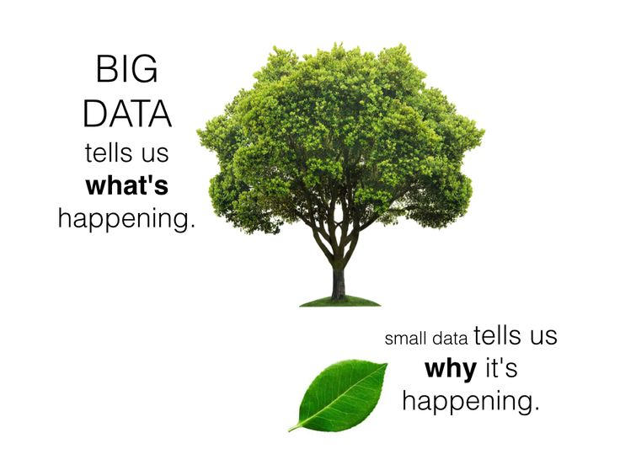
Notes:
Integrating Big and Small Data
Advantages
Parallels to efficacy vs effectiveness
A-B testing
it's not big data's fault- it's the way we use big data, it's our responsibility (data do not create meaning- we do)
relying on big data alone, increases the chances we'll miss something,
while giving us the illusion we know everything
"thick data" small samples but meaty, rich information about human experience
big data is then "thin data", I guess?
Netflix algorithm ($1m prize for improvements); hired an ethnographer, too, who discovered
the binge watching phenomenon
big data predictions reinfornce existing biases (police profiling predictions for bond amounts and sentencing;
NSA's skynet possibly resulting in 1000's of civilian deaths thru misreading cellular data)
the "quantification bias"

Slide 66
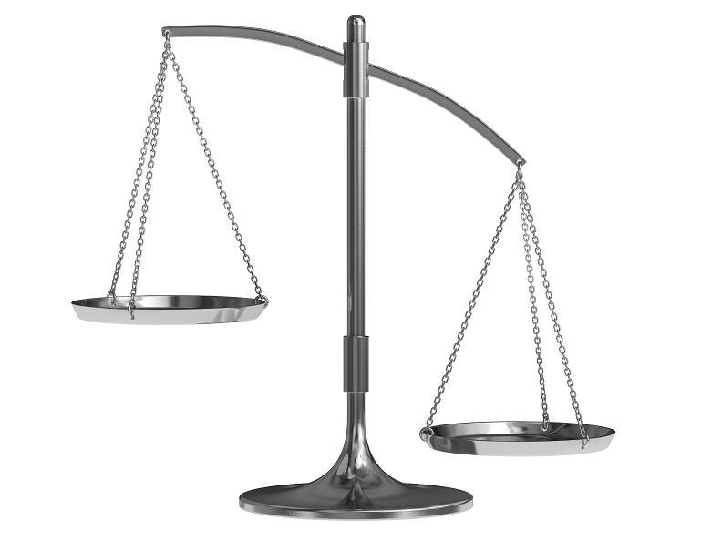
Replication
Increased stat power
Increased sample diversity
Increased low-base rate frequencies
Broader measurement
Extended periods of development
Data sharing to maximize data resources
Cumulative science
Sampling heterogeneity
Geographic heterogeneity
Historic heterogeneity
Study/practice design characteristics
(e.g., order of items can matter)
Measurement invariance and comparability
Notes:
The seduction of Bigger Data is strong, and I’m not suggesting we ignore the lure of data harmonizing. Rather, we should examine the veracity of its message in the same way we critique studies that generate small data. If we are ever to realize the full potential of Big Data’s predictive analytics, we need to be mindful of the pitfalls and rocky cliffs that Big and Bigger data possess.
sufficient levels of accuracy, are data rows representative of our target population
Were subjects assessed face-to-face or via telephone or internet? If face-to-face, was the assessment
conducted at the home of a subject or was the subject brought into a controlled facility? Was
the assessment conducted as a personal interview or was it computer-based? Was the same
assessment battery used at each time period or were items deleted and others added over time?
Clearly there are an unmanageable number of differences across studies in design
characteristics. In most typical IDA applications these differences are confounded with one
another.
measurement invariance and measurement
comparability

Slide 67



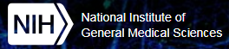

Thank you
David-Bard@ouhsc.edu
William-Beasley@ouhsc.edu
Thomas-Wilson@ouhsc.edu
Award Numbers UG1OD024950 and U54GM104938

